Slide 1

Artificial Intelligence for Business Decisions and Transformation
CSCN8030 - Spring 2024 - Section 2
Sprint 3 - Design
21 June 2024
Group 4 - Members:
Krishna Kumar, Hemasree
Shijin, Jency
Fernandez, Arcadio
Professor:
Glaucia Melo dos Santos, PhD

Slide 2
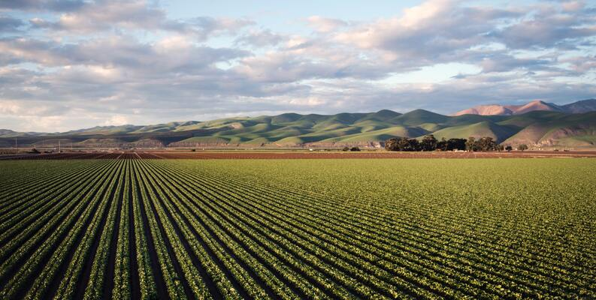
Crop Yield Prediction

Slide 3
Agenda
1. Group members role
2. Dataset and benchmark codes
3. Project Pitch
4. Sprint Planning
5. Reference

Slide 4


1. Group members role
Product owner
Developers
Jency
Arcadio
Hema
Connects with the customer
Contributes to the vision and roadmap
Manages and prioritizes the team backlog
Supports the team in delivering value
Continuously evolves product design
Implements the vision and roadmap
Works on the team backlog
Builds, tests, and delivers increments of value

Slide 5
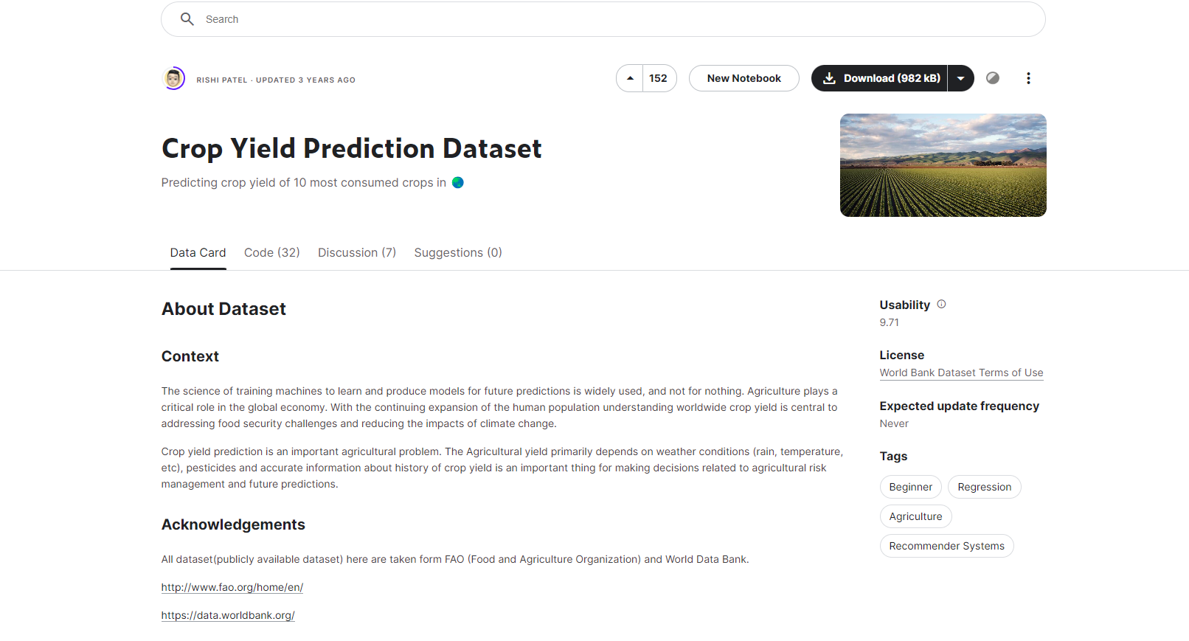
2. Dataset and benchmark codes
https://www.kaggle.com/datasets/patelris/crop-yield-prediction-dataset

Slide 6
3. Project Pitch
Project Pitch | BUSINESS
Organization or Category | Agricultural Research Organizations / Farmers
Description of Organization | Agricultural Research Organizations are dedicated to advancing the scientific knowledge and technological innovations within the agricultural sector. They conduct extensive research on various aspects of farming, including crop genetics, soil health, water management, pest and disease control, and sustainable agricultural practices. Farmers, who run small to medium-sized farms, are key players in agriculture. They make important decisions about crops, livestock, and resources, combining traditional knowledge with modern techniques to improve productivity and profitability.
Two Specific Ethical Considerations in AI Adoption | Privacy Preservation: It's essential to safeguard privacy and security of farmers' data, including sensitive information about agricultural practices and yields. Implement robust data protection measures, such as encryption and anonymization, to safeguard data. Obtain informed consent before data collection and ensure compliance with relevant data protection regulations. Algorithmic Bias Mitigation: Ethical considerations must be made to mitigate and address biases that could disadvantage certain groups of farmers or regions. Ensure fair distribution of benefits and resources from agricultural advancements to all farmers, regardless of their economic status or farm size.

Slide 7
3. Project Pitch
Three Examples of Operational Decisions | 1. Fertilizer Application:: Optimize fertilizer usage based on predicted yield to ensure crops receive the right nutrients at the right time, enhancing growth and reducing waste or environmental impact. 2. Pest and Disease Management Implement targeted pest and disease management practices based on yield predictions and historical data on pest outbreaks. High yield predictions may justify more intensive management to protect the potential yield. 3. Harvest Planning: Plan the timing and logistics of harvesting operations based on yield predictions to ensure efficient harvesting and minimal post-harvest losses. This will help to maximize crop quality and market value.
Three Examples of Tactical Decisions | 1.Seasonal Crop Planning: Plan the types of crops to be planted each season based on yield predictions and market demand. 2. Resource Allocation: Allocate resources such as fertilizers, water, and labor based on predicted yields for different crops and regions. 3. Market Timing and Sales Strategies: Develop sales and marketing strategies based on predicted harvest times and yields to optimize market timing.
Three Examples of Strategic Decisions | 1. Investment in Infrastructure Based on crop yield predictions, decide on the long-term investments in irrigation systems, storage facilities, and transportation infrastructure. 2. Crop Diversification Strategy: Develop a strategic plan for crop diversification to mitigate risks associated with monoculture and to optimize the use of soil and climate resources. 3. Policy Formulation for Sustainable Agriculture Formulate policies that promote sustainable agricultural practices based on long-term yield predictions and environmental impact assessments.

Slide 8
3. Project Pitch
Why this is topic important? | Crop yield prediction is important as it allows farmers to make informed decisions based on data-driven insights. For instance, accurate predictions can help farmers optimize irrigation, leading to water savings in some cases. Additionally, it aids in planning fertilizer use more efficiently, potentially reducing nitrogen fertilizer applications while maintaining or increasing crop yields. Such precision helps mitigate environmental impacts and improves overall farm profitability.
How could this project make an impact outside of class? | This project can make a real-world impact by helping farmers grow more crops efficiently and sustainably. It provides them with tools to predict yields accurately, manage resources wisely, and adapt to environmental changes, ultimately boosting farm productivity and ensuring food security. Additionally, it promotes better agricultural practices that benefit the environment and society as a whole.
Why should class choose this topic? | This project provides a unique opportunity to specialize in agricultural applications, where we can master techniques like predictive modeling for crop yield forecasts and optimization algorithms for resource management. It offers hands-on experience with real-world agricultural data, enhancing our skills in data analysis and domain-specific knowledge. This project not only prepares us for solving practical challenges in agriculture but also positions us at the forefront of leveraging AI and ML to address global food security and sustainability issues.

Slide 9
4. Sprint Planning
Tasks | Owner | Priority | Sprint | Story Points | Estimated Effort in Hours
Perform Data integration by merging pesticides, rainfall, temp, yield, and any other relevant information by identifying common keys or fields. | Hema | med | 1 | 3 | 1
Clean the data by handling missing values, correcting data types, and ensuring data consistency. | Hema | med | 1 | 3 | 1
Explore the dataset to understand its structure, features, and distributions to gain insights into crop yield data, pesticides data , weather condition which is relevant for prediction. | Hema | high | 1 | 5 | 2
Identify relevant features such as weather patterns, seasonal trends for crop yield prediction | Jency | high | 1 | 5 | 2
Encode categorical variables into numerical format using techniques like one-hot encoding or label encoding. | Jency | med | 1 | 3 | 1
Scale numerical features to ensure they have similar ranges, which can improve the performance of ML algorithm. | Jency | med | 1 | 3 | 1
Choose appropriate prediction algorithms based on business objectives | Arcadio | med | 1 | 3 | 1
Implement chosen prediction algorithms on the preprocessed and integrated dataset. | Arcadio | high | 1 | 5 | 4
Assess the model using appropriate metrics such RMSE and generate valuable insights | Arcadio | high | 1 | 5 | 3

Slide 10
Thank you
Any Questions

